Slide 1
Fake News Detection
NLP PROJECT P467
BY GROUP - 6

Slide 2
Group Members
Lokesh Goyal
Yuvraj Dilip Kamble
Nandani Sah
Pradeep Kumar
Abhishek Sharma
Krishna Dharmik Dhamecha

Slide 3
Index
Indroduction
Objective
Data Visualization
Model Building
Model Comparision
Deployment
Challenges

Slide 4
Introduction
Fake news refers to fabricated stories or false information intentionally designed to mislead or deceive readers.
These stories are often created to manipulate public opinion, promote a political agenda, create confusion, or generate profit for online platforms.

Slide 5
Objective
The goal of this project is to create a machine learning system that can identify whether a news article is "Fake" or "Real" by analyzing its text.
This system is designed to help tackle the problem of false information by using smart techniques to understand and process the text effectively.
We have used NLP and preprocessing methodologies like Tokenization, Stop words Removal, Lemmatization, Stemming and Machine Learning classification Algorithms – Logistic Regression, Navie Bayes, Random Forest, Decision Tree, and Neural Network to build a model that differentiates between Fake News and Real News.

Slide 6
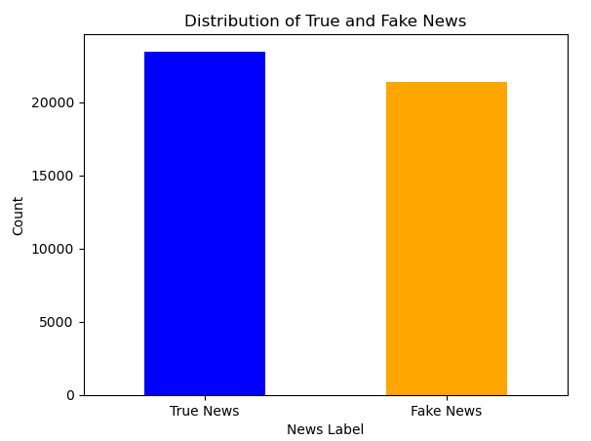
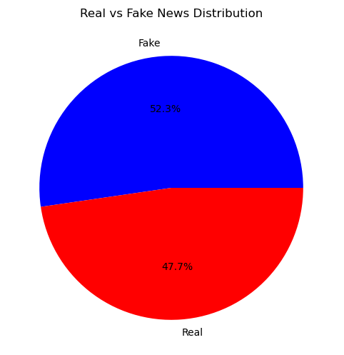
Data Visualization
Bar Chart: Shows raw counts 23, 481 Fake news articles and 21,216 Real news articles in the dataset
Pie Chart: Represents the same data as percentages, with fake news making up 52.3% and real news 47.7% of the total.

Slide 7
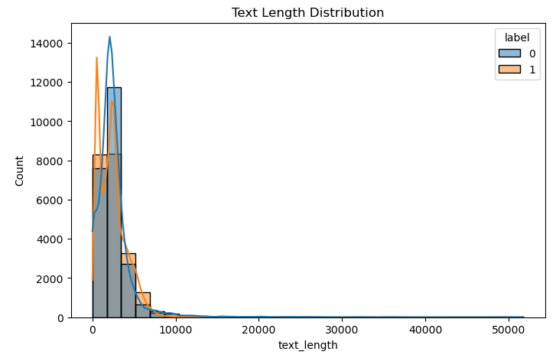
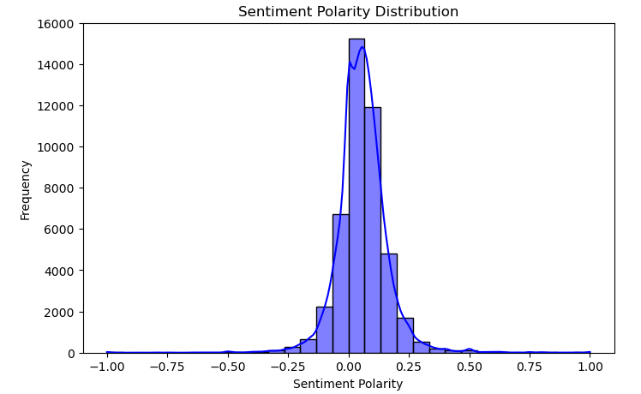
Both the Combo charts showing “Text Length Distribution” & “Sentiment Polarity Distribution” respectively

Slide 8
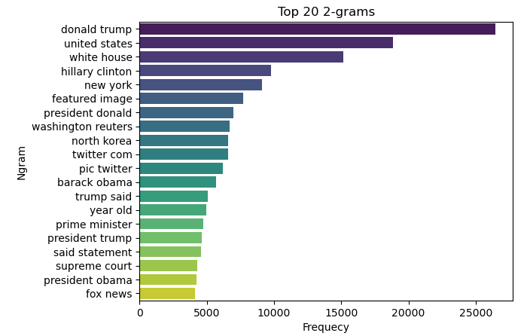
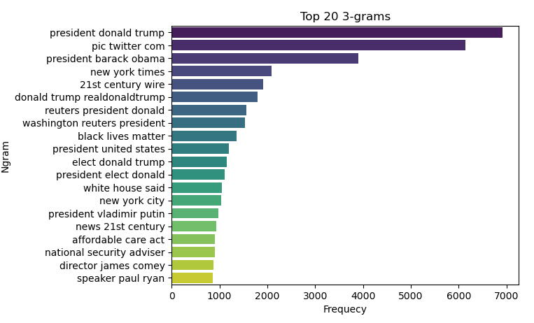
Bar charts showing most frequetly used words
Both the N-grams show the Top-20 frequents words. We can see the 2-grams most frequent word is “donald trump” and 3-grams frequent word is “president donald trump”.

Slide 9
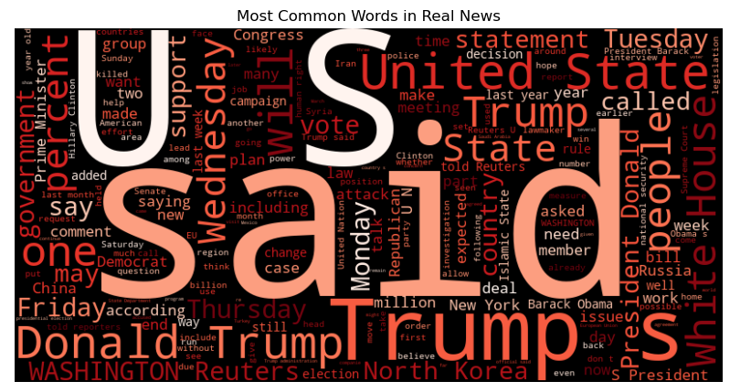
Real News World Cloud
We can see said, US, Trump, United State, Donald Trump, white house etc… most frequent word in real news.

Slide 10
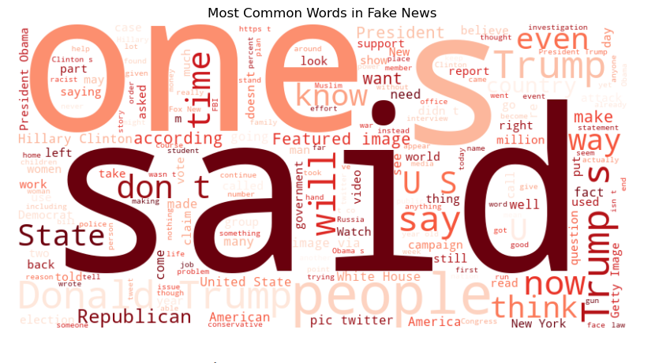
Fake News World Cloud
We can see one, Said, people, trump, Donald trump etc… most frequent word in fake news.

Slide 11
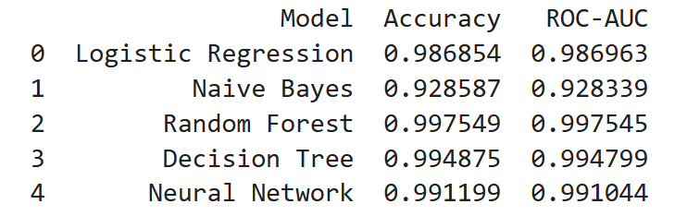
Model Building
Out of all the algorithms we used to build the model, the “Random Forest Classifier” give us the best results with an accuracy of 99.75%, which is almost perfect!

Slide 12
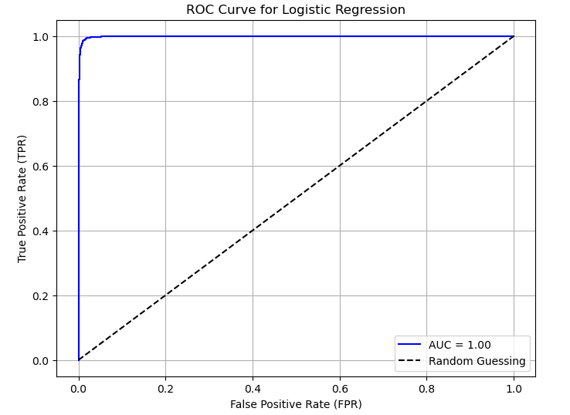
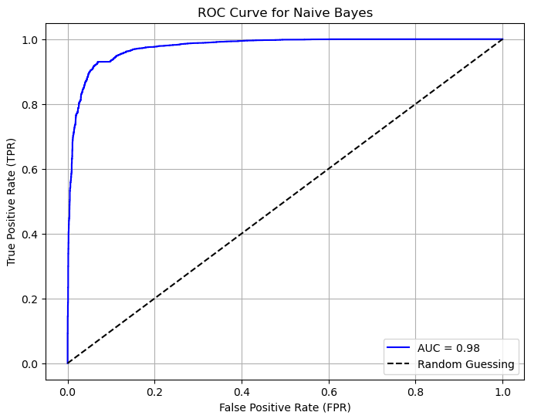
ROC-AUC
The ROC Curve helps us understand how well a model can distinguish between different classes. The AUC (Area Under the Curve) tells us how good the model is overall. A higher AUC means the model is better at making correct predictions. In this case, the Random Forest classifier has the highest AUC, which means it performs the best and gives the most accurate results among the models we tested.

Slide 13
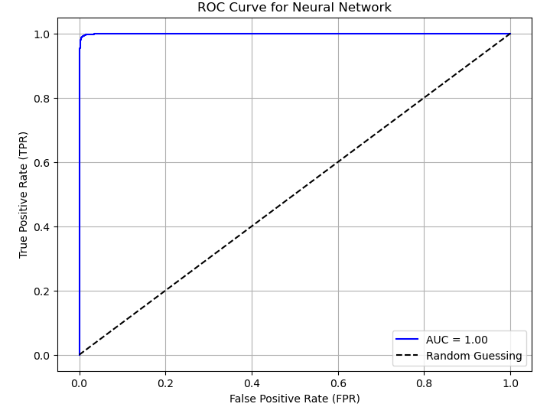
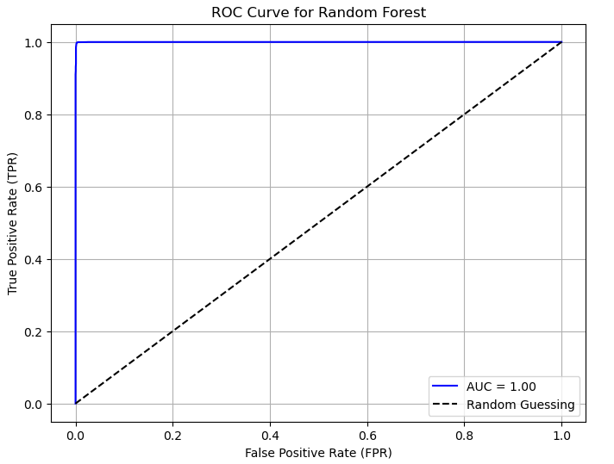
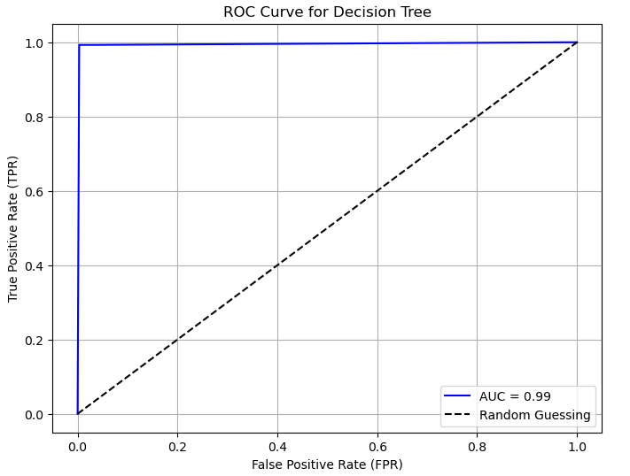

Slide 14
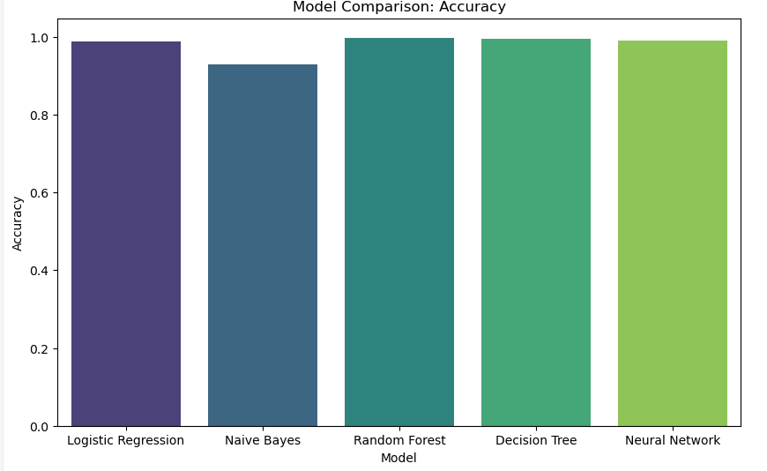
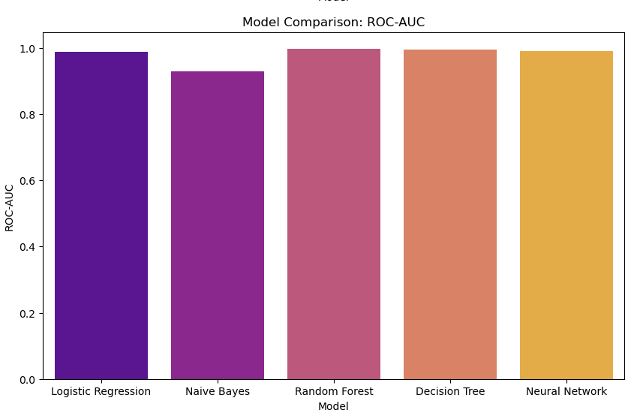
Model Comparision
All models perform well with accuracy and ROC-AUC above 90%. Random Forest, Decision Tree, and Neural Network slightly outperform Logistic Regression and Naive Bayes, with Naive Bayes having the lowest ROC-AUC.

Slide 15
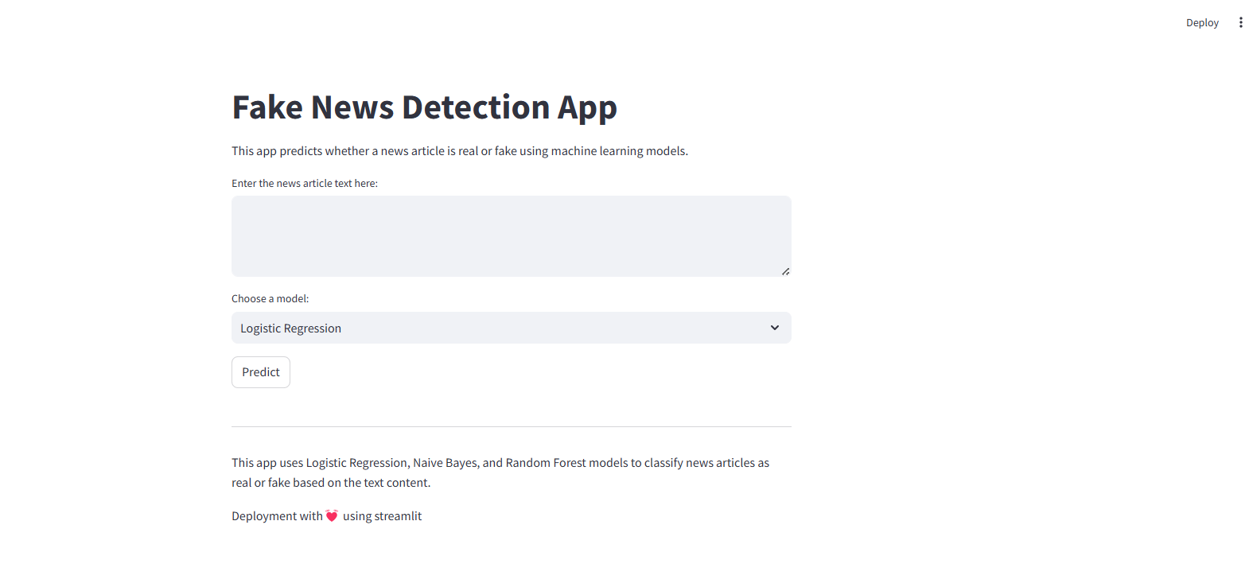
Deployment

Slide 16
This is a web interface for a Fake News Detection App. The application features:
A text input area where users can paste news article content
A dropdown menu to select from different ML models (including Logistic Regression)
A "Predict" button to analyze the text
Built using Streamlit framework
Uses three models (Logistic Regression, Naive Bayes, Random Forest) to classify news as real or fake
The interface is simple and user-friendly, designed for easy interaction with the fake news detection system.

Slide 17
Challenges
Understanding Project Goals:
Words with multiple meanings or different words with similar meanings
Solution : Augment datasets with examples that cover ambiguous or contextually rich cases
Tokenization and Representation:
Challenges with words having multiple meanings or synonyms.
Solution: Enhance datasets with diverse and context-specific examples.
Model Choice and Adaptation:
Determining the best model for the task.
Solution: Experiment with multiple models and compare results.
Overfitting and Generalization Issues:
Good performance on training data but poor results on new data.
Solution: Use thorough cross-validation and expand datasets with varied samples.

Slide 18
THANK YOU

